Slide 1
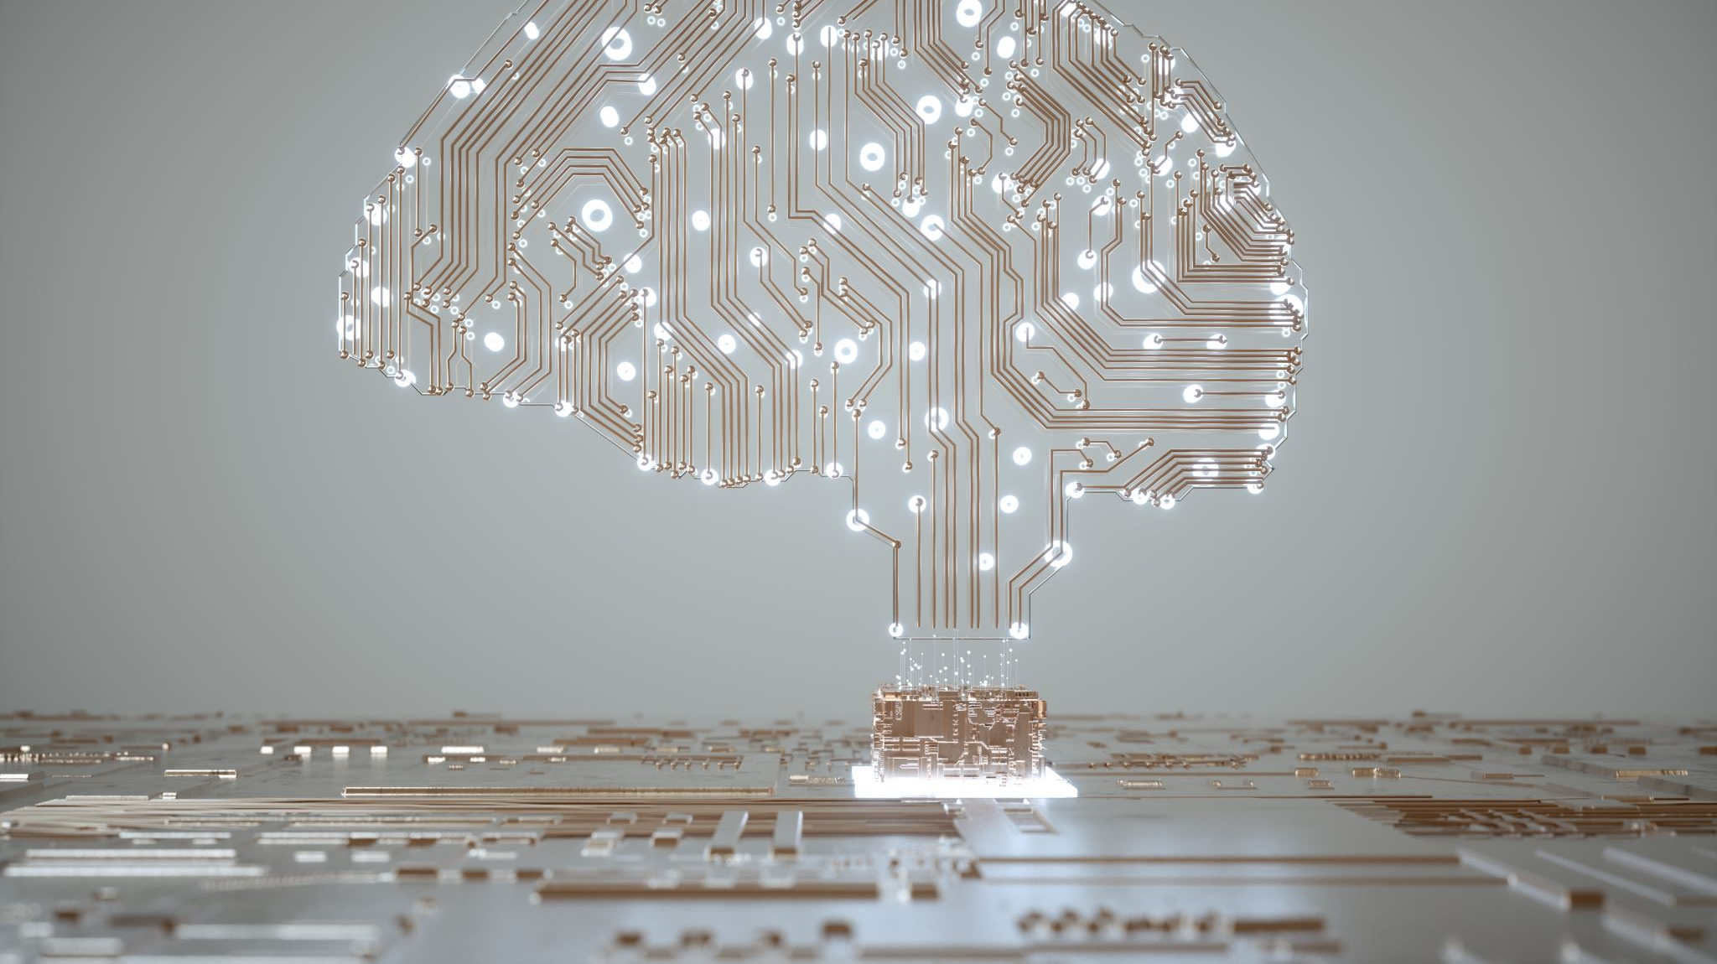
AI Business Education
Lubar Business School

Slide 2
Curriculum
Introduction to AI
History of AI
Types of AI
Decision of AI (What to use and When)
Cognitive AI
Machine/Deep/Reinforcement Learning – AML Services

Slide 3
Types of AI
Cognitive – Pre Built
ML/DL/RL – Custom Build from Scratch

Slide 4
Decision Tree

Slide 5
AI Business school
Conversation AI
AI Services
Knowledge Mining
Autonomous Systems
Responsible AI
Link

Slide 6

AI Services
Cognitive Services – link
Data Science Program/Project Management – TDSP
Trainer training link
AI Business school link
Cognitive Services – create
Responsible AI for business link

Slide 7
AI Services
Custom Vision link
AI Services Link
Form and Object extraction link
Intro to Translator link
Speech to text link
Speech processing – link
Metric advisor link
Azure ML SDK link
Automated ML link

